Slide 1
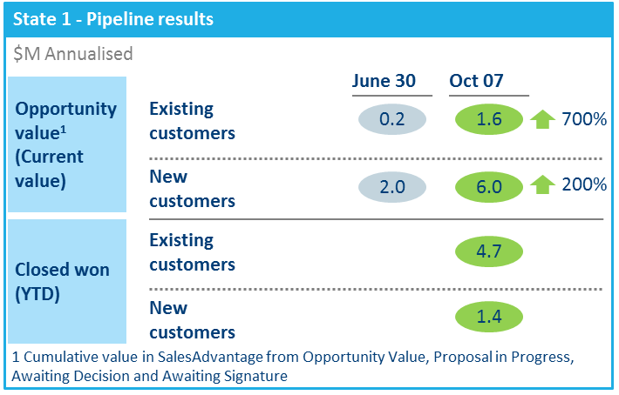
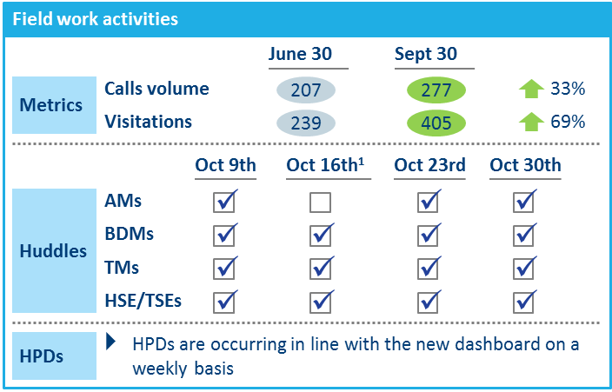

Bonus points if you have engaged our New Client Service Capabilities (eg. Advanced data & analytics, Digital Labs, McKinsey Solutions & etc) in your M&S study
Basic Materials (GEM) | Asia-Pacific
BAS026
Situation
What we did
Impact (focused on SME)
Waste management provider
ASX Top 100, employing 4,500+ people across Australia at over 200 sites and depots and over 300 products and services.
Losing market share in a growing market
Needed step change in cost reductions - double digit savings
Capability building and to enable sustainability
Improved National Account win rates
Launched a National Accounts war room
Improved the tender response process
Improved SME pipeline opportunity value ~+250% in 4 months
Won and retained more SME customers and concentrated focus on mid-market accounts
Increased share of wallet of existing customers
Created a lead generation engine
Promoted cross-selling campaigns
Provided sales support: including save desk and telesales
Boosted sales and marketing skills
Developed a ‘new way of working’ and train sales reps through a series of forum and field
Enhanced performance management
Aligned incentives
Provided tools to allow reps to focus on selling
Forum and Field executed in 3 states: 50+ sales reps trained, in 3 states with a plan to train a further 40+ across AU using MDL Sales Ninja solution

